Slide 1
Time-dependent solution
;

Slide 2
Infinite cable
Boundary condition:
If (an infinitely brief pulse)
For long times, decay pattern is the same throughout the cable.

Slide 3
Since the system is linear, response to arbitrary current injection is given as,

Slide 4
Voltage response to current step:

Slide 5
Propagation Delay:
Linear cable equation does not admit any wave equation, due to dissipation of energy through the passive membrane.
If voltage-sensitive, nonlinear elements are present, then we can have traveling waves as it happens in the axons.

Slide 6
One way of defining velocity is by tracking motion of the peak.
But a centroid gives uniform propagation velocity.

Slide 7
Transfer delay
Transfer delay is the difference in centroid of induced voltage at y, and the centroid of injected current at ‘x’.
Input or local delay:

Slide 8
D_{xy} is always positive and is independent of the shape of the transient input current.
It is the property of the cable and not of the input waveform
No matter what the electrical structure of the cable, the transfer delay is symmetric.

Slide 9
Isopotential neuron – membrane patch:
Infinite or semi-infinite cable:
If the current is injected at x and the voltage is recorded at y, the two centroids are displaced by,

Slide 10
Propagation delay in difference between centroids of voltage at x and y:
For an infinite cable,

Slide 11
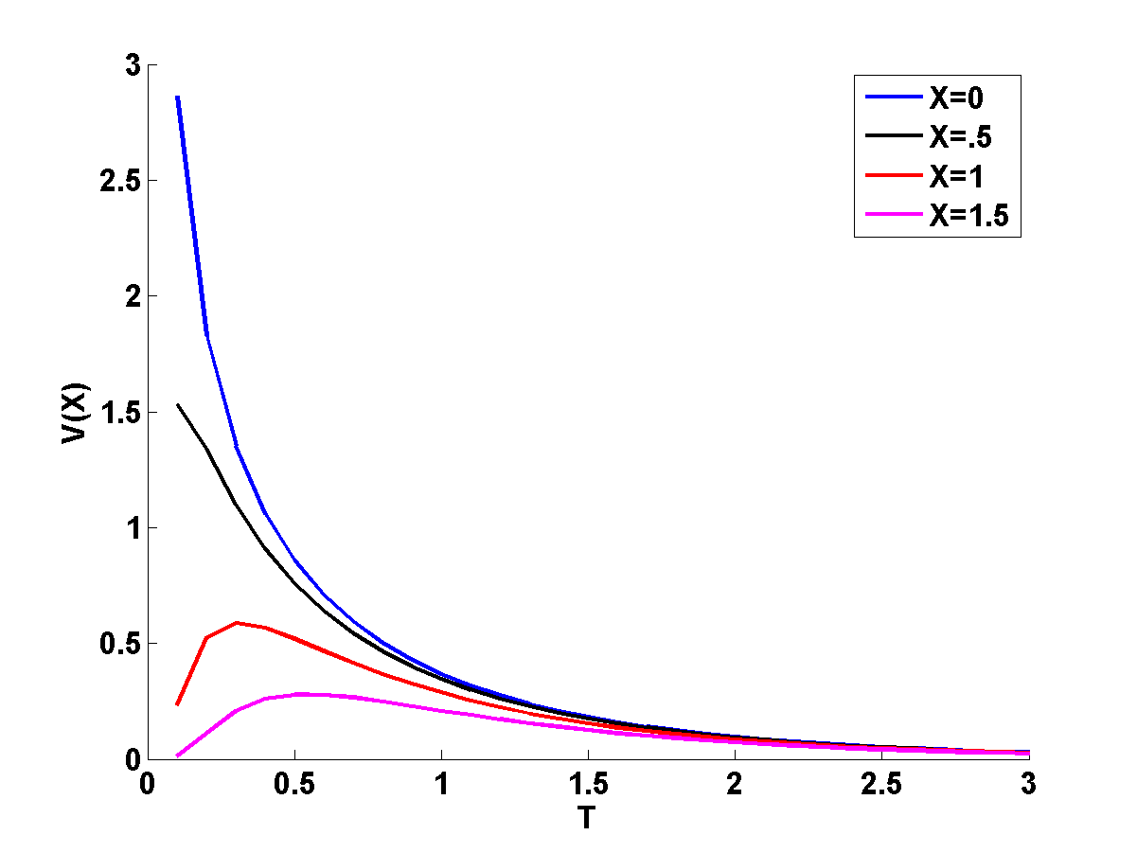
Example
Plot the time dependant solutions for different distances from the point of injection for a semi-infinite cable with respect to time. Current is injected at X=0;
Solution:
The required plots can be generated using the formula:
Approximating it as:
We plot the X's(distance's) at intervals of 0.5.

